Slide 1
XchangeIt Currency Exchange Rate Converter.

Slide 2
Agenda
Introduction
Team members
Features
Objectives
Technologies used
Application flow
Future enhancements
Agile task board
Summary and contributions
Conclusion and next steps

Slide 3

Project overview.
XchangeIt is a C#-based application for converting amounts from one currency to another.
It Supports multiple currencies using live exchange rate APIs or fixed local data sources.
Notes:
Speaker Notes: Our project XchangeIt is a currency exchange rate converter developed in C#. It is designed to allow users to convert a specified amount from one currency to another quickly and accurately. We chose C# for its robust framework and reliability, which helps ensure our converter is stable and well-structured. The application supports a wide range of world currencies, making it versatile for various conversion needs. Importantly, it can fetch live exchange rates from online APIs for up-to-the-minute accuracy, or use fixed local data sources when an internet connection is unavailable. This dual approach means the converter remains functional in all scenarios, demonstrating flexibility and user-centric design.

Slide 4

Team Members
Ha Phuong Anh (A00323123)
Luthfat Muhammed (A00305747)
Lizza Martinez (A00325183)
Notes:
Speaker Notes: Our team consists of three members: Ha Phuong Anh, Luthfat Muhammed, and Lizza Martinez. Each of us played an integral role in developing this project, and we collaborated closely throughout the process. By combining our individual strengths in programming, design, and testing, we ensured that the final product is robust and well-rounded. This teamwork allowed us to tackle challenges efficiently and maintain a high standard of quality in our currency converter.

Slide 5
Features
Convert between multiple world currencies
Support for both current and historical exchange rates
Console or Windows-based UI options (WinForms/WPF)
Modular design using interfaces for extensibility
Optional API integration for real-time exchange rates
Input validation and user-friendly feedback
Calculator
Notes:
Speaker Notes: Now, let us highlight the key features of our currency converter. First, it can convert between multiple world currencies, not just a fixed pair of currencies, which demonstrates the broad applicability of our tool. It also supports both current and historical exchange rates, meaning a user can perform conversions using today’s rates or look up rates from a specific past date. This historical rate feature adds an analytical dimension, allowing users to see what the conversion would have been at a previous time.
Our application offers flexibility in how users interact with it. We developed both a simple console interface and a graphical Windows-based interface (using WinForms or WPF). Users can choose the interface that best suits their needs – the console is quick and straightforward, while the GUI is more user-friendly and visually intuitive. Additionally, the system has a modular design with interfaces, making it easily extensible. This means we can add new functionalities or support additional currencies in the future without major changes to the codebase, thanks to the way the components are decoupled.
We also included optional API integration. This feature allows the converter to fetch real-time exchange rates from external services (for example, pulling data from a site like Fixer.io) whenever up-to-date information is needed. Finally, we placed strong emphasis on input validation and user-friendly feedback. The converter checks for valid inputs (such as ensuring the amount is a number and the currency codes are correct) and provides clear error messages or guidance if something isn’t right. This robust input handling ensures a smooth user experience and prevents errors during the conversion process.

Slide 6
Objectives
Develop a reliable and functional currency converter
Implement accurate currency conversion logic
Ensure a clean and user-friendly interface
Validate inputs and manage errors gracefully
Support future enhancements like charts, alerts, and history
Notes:
Speaker Notes: At the outset of the project, we defined clear objectives to guide our development. Our first goal was to develop a reliable and fully functional currency converter, meaning the application should perform conversions correctly every time and handle all basic requirements without fail. Accuracy was critical – we aimed to implement precise currency conversion logic so that users can trust the results for any currency pair and amount.
We also made the user interface a priority. One objective was to ensure a clean and user-friendly interface, because a tool is only effective if it is easy to navigate and understand. Hand-in-hand with that, we set a goal to validate inputs and manage errors gracefully. This objective was about making the converter robust against invalid inputs or unexpected situations: for example, if a user enters a non-numeric value or an unsupported currency code, the application should catch that and inform the user politely, rather than crashing or producing incorrect data.
Finally, we wanted to keep an eye on the future. We explicitly included an objective to support future enhancements like charts, alerts, and history. Even though these features might be beyond the initial scope, designing the system with them in mind ensures that our architecture is flexible. This forward-looking goal means the project is structured in a way that adding new features such as exchange rate trend charts, notification alerts for rate changes, or conversion history logs can be done seamlessly down the road. By meeting these objectives, we ensured our project not only fulfills its current requirements but is also poised for growth.

Slide 7
Technologies Used
Language: C#
UI Options: Console App, WinForms, WPF, Github, Microsoft Visio.
Data Sources: Fixed rate files (JSON/XML) or online APIs (e.g., Fixer.io, Trillo)
Notes:
Speaker Notes: In terms of technology, our project is implemented in the C# programming language. We selected C# because it is well-suited for building reliable Windows applications and it provided us with robust libraries for both the user interface and data processing. This choice gave us confidence in the performance and stability of our converter.
For the user interface, we actually explored two approaches: a command-line console application and a graphical interface using Windows Forms or WPF. The console version was straightforward to develop and great for testing the core logic. On the other hand, the WinForms/WPF interface offers a richer, more intuitive user experience with buttons, text boxes, and other controls. By developing both, we demonstrated that our solution can adapt to different user preferences and scenarios – from a quick console utility for developers or power users, to a friendly GUI for everyday end users.
Regarding data sources for exchange rates, our converter is designed to work either offline or online. It can use fixed rate data files (for example, a JSON or XML file containing exchange rates) stored locally. This is useful for offline use or for consistent testing with known values. Additionally, the application can connect to online exchange rate APIs (such as the Fixer.io API, among others) to retrieve real-time rates. By supporting both local data and live APIs, we combined the reliability of having an offline fallback with the accuracy of up-to-date information from the internet. This technology choice makes our currency converter both flexible and dependable.

Slide 8
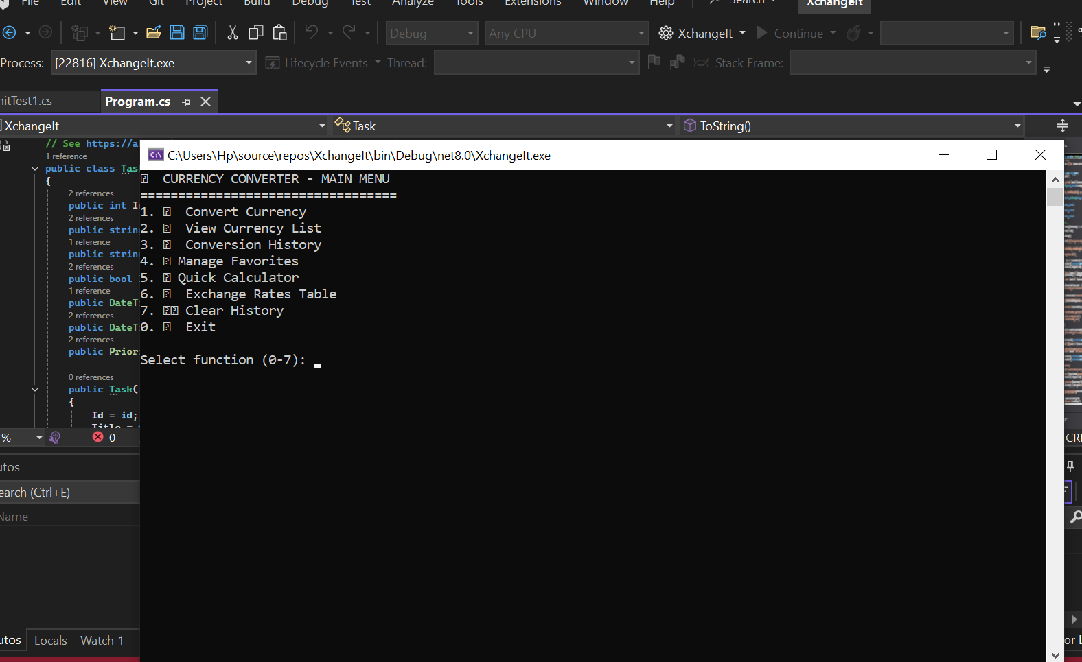
Main Functions from Microsoft Visual Studio

Slide 9
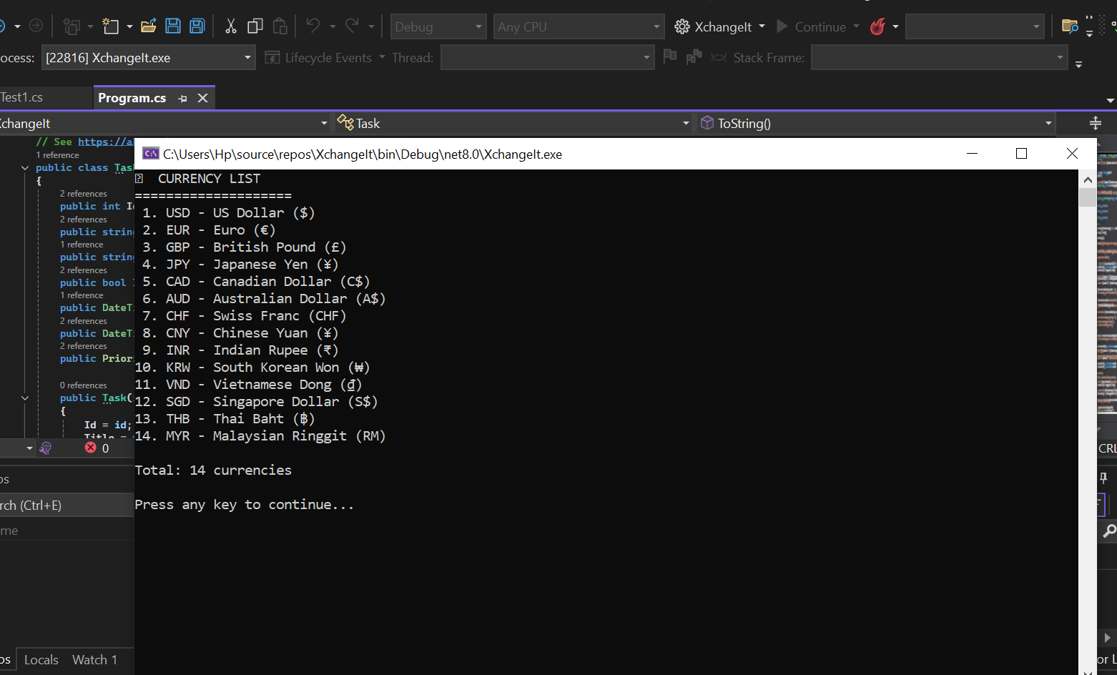
List of currencies on XchangeIt currency converter.

Slide 10
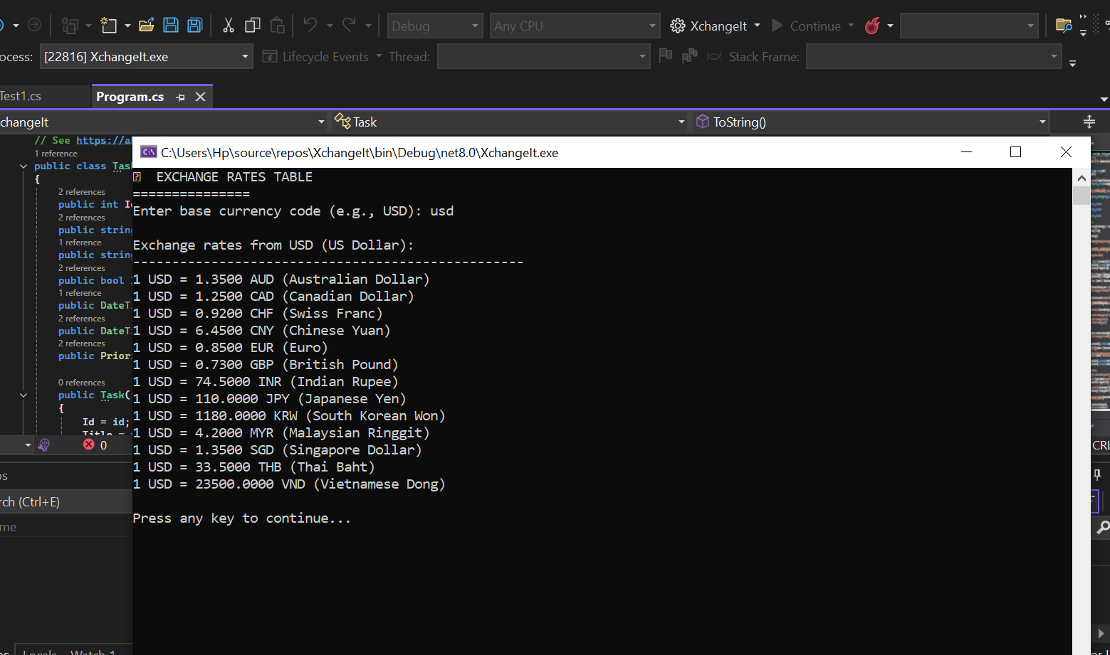
Exchange Rate table for USD

Slide 11
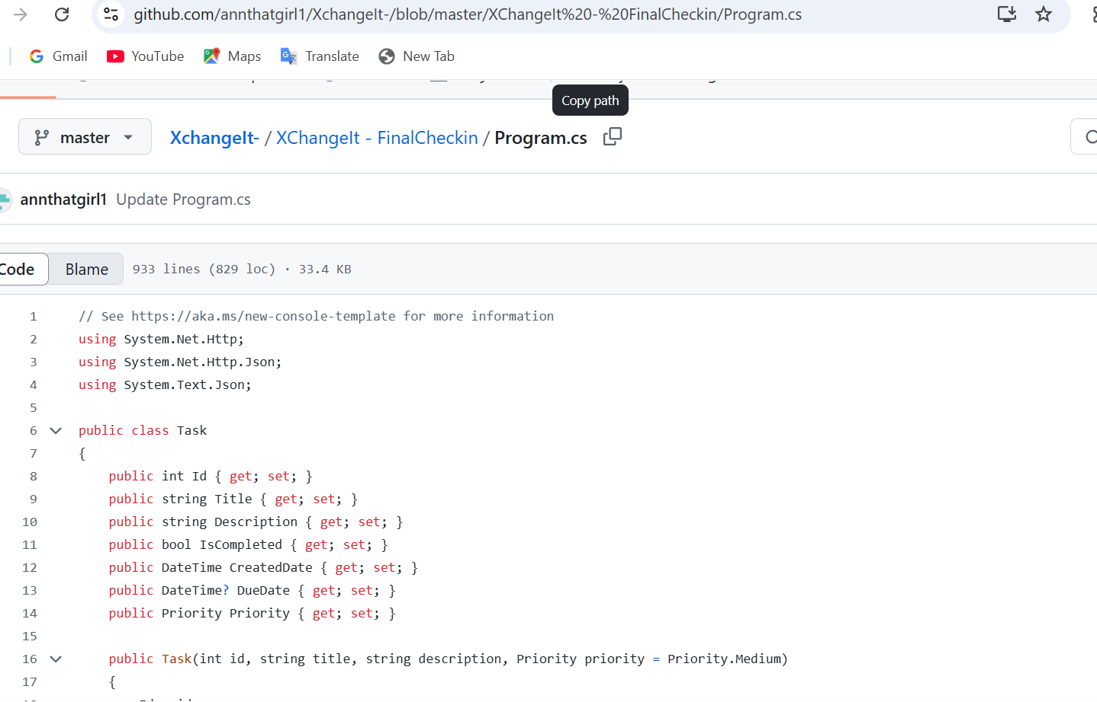
Code on Github

Slide 12
Application flow
Launch: User opens the application.
Input: User enters the amount, source currency, target currency, and an optional date for historical rates.
Fetch Rate: The app retrieves the exchange rate from a chosen source (local JSON/XML data, a historical file, or an online API).
Calculate: The conversion is computed (amount × exchangeRate).
Output: The converted result is displayed through the user interface
Notes:
Speaker Notes: Let’s walk through how a user would interact with our application, step by step. First, the user launches the currency converter program. Once the application is running, it immediately prompts the user to enter the details required for the conversion. The user will input the amount of money they want to convert, select the source currency (for example, USD for US dollars) and the target currency (say EUR for euros), and if they wish, they can also specify a date for a historical exchange rate. This optional date input allows the user to convert using the rate from a particular past date if needed (for instance, what was the rate last week or last year).
After the user provides the necessary inputs, the application proceeds to fetch the appropriate exchange rate. Depending on the settings or user’s choice, the converter will either load the rate from a local source or contact an external service. It might read from a fixed local JSON/XML file that we have bundled with historical and current rates, or it could reach out to an online API to get the most current rate available. If a historical date was specified, the application will look up the rate for that exact date, either from the local historical data file or via an API that provides historical rates. This design ensures the user gets the correct rate for their specific request.
Once the exchange rate is obtained, the application calculates the conversion. The formula is straightforward: it multiplies the input amount by the exchange rate to determine the converted amount in the target currency. We made sure to handle this calculation with proper data types and rounding to maintain accuracy. Finally, the output is displayed to the user. If the user is running the console version, the result will simply be printed to the console window in a clear format (e.g., "100 USD = 85 EUR"). If the user is on the GUI version, the converted amount is shown in a dedicated field or message box in the interface. At this point, the user can see the outcome of their request. The process is designed to be straightforward and fast, providing a seamless experience from input to output.

Slide 13
Future Enhancements
Add exchange rate trend charts
Enable alert notifications for rate thresholds
Maintain conversion history and logs
Implement localization and multi-language support
Notes:
Speaker Notes: Although our core project is complete, we have several ideas for future enhancements that would make the currency converter even more powerful. One enhancement we envision is adding exchange rate trend charts. With trend charts, users could visualize how a currency’s value changes over time. This would transform our converter from a simple transactional tool into a more analytical tool, helping users spot trends and make informed decisions at a glance.
Another planned enhancement is an alert notification system for exchange rate thresholds. This feature would let users set up alerts so that the application notifies them when a certain exchange rate reaches a predefined threshold. For example, if someone is waiting for the dollar-to-euro rate to fall below a certain value before converting money, they could set an alert and our app would ping them once that condition is met. This proactive feature would make the app more interactive and helpful for users tracking specific currencies.
We also see value in maintaining a conversion history and logs. In a future update, the application could keep a record of all conversions a user performs. This history log would let users review past conversion results – for instance, to recall how much they converted last month or to track their conversion activities over time. It’s a useful feature for power users or anyone who needs to refer back to previous transactions.
Lastly, localization and multi-language support would be a significant enhancement, especially as we consider a broader user base. Right now, the app’s interface and messages are in English. By adding localization, we would enable users to choose their preferred language, and the app would adapt all labels, prompts, and possibly currency formats to that locale. This would make the converter accessible to non-English speakers and more user-friendly internationally. All these enhancements (charts, alerts, history, and multi-language support) were identified early on and kept in our backlog. While they were beyond the scope of the initial project delivery, our design decisions have kept the door open for implementing these features in the future.

Slide 14
Agile Task Board (Progress Tracking)
Backlog: Planned tasks not started (e.g., charts, alerts, localization, user manual)
In Progress: Tasks currently underway (presentation prep, testing integration, UI improvements)
In Review: Work awaiting review (real-time API integration, transaction log feature)
Completed: Finished tasks (initial meeting, core conversion, validation, data integration, etc.)
Notes:
Speaker Notes: To manage our workflow, we adopted an agile methodology and used a task board to track progress. This Agile task board is divided into four categories: Backlog, In Progress, In Review, and Completed. It helped us visualize the project’s status at any given time and ensured accountability among team members.
The Backlog contains tasks that we planned but have not started yet. For our project, the backlog included the future enhancement ideas we just discussed – for example, adding trend charts, implementing the alert system for certain rate thresholds, adding localization support, as well as creating a detailed user manual for the application. These items were recognized as valuable but were scheduled for later implementation, beyond the initial scope.
The In Progress column shows the tasks we are actively working on at the moment. Currently, this includes preparing the final presentation (which all of us contributed to), integrating software tests into the codebase, and polishing the user interface for better usability. Seeing these tasks in progress allowed us to focus our efforts and collaborate where necessary – for instance, Luthfat has been leading the testing and UI improvements while we all worked together on the presentation.
Next is the In Review column, which holds tasks that have been completed by a team member but are undergoing review or testing before being fully accepted. In our case, the real-time API integration feature is in review, as well as the new transaction history feature. These were implemented (both primarily by Lizza) and then submitted for peer review and testing. The In Review stage ensured that we double-checked critical features and maintained quality by having others verify the work before it was finalized.
Finally, the Completed column lists all the tasks that have been finished. This section of our board highlights our accomplishments. It includes things like our initial project planning meeting with the professor, the basic currency conversion functionality (our first working version of the converter), and important features such as input validation and error handling (completed by Luthfat), local JSON file integration for fixed rates (completed by Ha Phuong Anh), and the historical rate lookup implementation (completed by Lizza). We also set up a GitHub repository early on and made regular commits, which is recorded as a completed task. Seeing these tasks in Completed gave us a sense of progress and accomplishment. Overall, using the agile task board was very effective – it kept our team organized, facilitated communication about who is doing what, and ensured that nothing fell through the cracks as we worked on the project.

Slide 15
Summary of Contributors.
Ha Phuong Anh: Integrated local fixed-rate JSON data and coordinated final presentation deliverables.
Luthfat Muhammed: Led input validation & error handling and spearheaded testing integration and UI polish efforts, also put together ppt for presentation.
Lizza Martinez: Implemented historical rate lookup and developed real-time API integration & transaction history features.
Entire Team: Collaborated on core functionality (initial meeting, basic conversion, repository setup) and collectively prepared the presentation.
Notes:
Speaker Notes: We would like to acknowledge each team member’s contributions to the project. Ha Phuong Anh took the lead in integrating local data sources. She implemented the functionality to read exchange rates from a local JSON file and incorporate those fixed rates into the converter’s calculations. This was crucial for enabling offline use of our application. Anh also played a key role in our project documentation and presentation – she coordinated the preparation and uploading of the final presentation materials to ensure we met our submission requirements.
Luthfat Muhammed focused on the quality and reliability of our application. She led the effort on input validation and error handling, implementing robust checks so that the program can gracefully handle invalid inputs or unexpected scenarios without crashing. This greatly improved the user experience and stability of the converter. Luthfat is also spearheading the integration of software testing into our codebase – writing unit tests and integration tests to verify that each part of the application works correctly. In addition, she worked on polishing the user interface to make the application more intuitive and user-friendly, demonstrating a strong commitment to both functionality and usability. Lastly, she helped put together the ppt for the final presentation.
Lizza Martinez concentrated on expanding the converter’s features, particularly those involving external data. She implemented the historical exchange rate lookup capability, which allows users to retrieve and use past exchange rates for conversions. Lizza also spearheaded the real-time API integration, coding the part of the application that fetches live rates from an external service. Moreover, she began developing the transaction history feature after our first check-in, laying the groundwork for the app to log and display past conversion transactions. Her contributions significantly enhanced the functionality and depth of our project.
Finally, as an entire team, we collaborated on all core aspects of the project. We jointly handled the initial setup tasks: for example, all of us participated in the early project planning meeting with our professor and in initializing the GitHub repository for version control. Throughout the development, we worked together on implementing the basic currency conversion logic and ensuring the fundamental features were in place. We also collectively prepared and reviewed the final presentation. This high level of teamwork ensured that we capitalized on each member’s strengths and maintained consistency across all parts of the project. In summary, every member made vital contributions, and our success is the direct result of our effective collaboration.

Slide 16
Conclusion and Next Steps
Project Completed: Delivered a functional currency converter meeting all initial objectives (reliable, accurate, user-friendly).
Lessons & Achievements: Gained hands-on experience in C# development, agile teamwork, and project management while meeting project milestones.
Next Steps: Plan to implement remaining features (trend charts, alerts, history logs, multi-language support) and further refine the application.
Notes:
Speaker Notes: In conclusion, our team successfully built the Currency Exchange Rate Converter and met all the objectives we set out to achieve. The final product is a reliable and accurate currency conversion tool with a clean, user-friendly interface – it fulfills the requirements of the project and provides a solid solution to the problem we aimed to solve. Along the way, we have learned a great deal. We honed our C# development skills and gained valuable experience in designing and implementing a complete application. We also practiced effective teamwork and agile project management, coordinating our efforts through regular meetings and the task board to hit our milestones. These experiences are as much a takeaway from the project as the working software itself.
As for next steps, we are enthusiastic about the potential enhancements we could bring to this project moving forward. Given more time, we plan to implement the additional features that remain in our backlog, such as the exchange rate trend charts, alert notifications for certain rate changes, conversion history logs, and full multi-language support. Implementing these features would elevate the converter to the next level, making it not only feature-rich but also more engaging and useful to a broader audience. Our codebase and design are structured in a way that we can continue to build on this foundation, so we’re confident that these enhancements can be integrated smoothly in the future.
Overall, we are proud of what we have accomplished with this project. We started with a concept and developed it into a functioning application that demonstrates technical proficiency and thoughtful design. This project has been a great opportunity to apply what we’ve learned in our coursework to a real-world scenario. Thank you for your attention and interest in our Currency Exchange Rate Converter. We appreciate the guidance we received throughout the project, and at this time, we would be happy to answer any questions.

Slide 17

Thank you for listening.
Feel free to ask your questions.

